Slide 1
Visualizing Netflix!
Group 15 – dsc 530

Slide 2
Introduction
Netflix is an online streaming platform that millions of people use around the world to consume content like movies and tv shows.
Netflix originated in 1998 as DVD rentals, and now they serve an audience of over 150 million people.
In this project, we will dive deep into the ever expanding metaverse of Netflix and try to visualize it to gain meaningful insights from it.
Throughout this project we’ll be using the Netflix brand color palette to make our visualizations seem coherent with the brand identity. This will also allow all of our visualizations to remain consistent with each other.

Slide 3
MARKS AND CHANNELS
Our dataset contains several categorical attributes such as Title, genre, type etc.
Our dataset contains several ordered attributes as well such as country, ratings, duration etc.
For geospatial visualization we use color hue as one of the channels to differentiate between countries that are producing the most and least amount of content. The color range is the same as Netflix brand color palette.
For time analysis series we used length as one of the marks to differentiate between the frequency of content in each year. We also made use of area as a mark to see which type of content is more prevalent on Netflix.
For relationship diagram we employed spatial region as well as area to depict which genre is more popular on Netflix and gets more rating respectively.

Slide 4
what
The dataset that we used for this project contans around 9,000 entries of different movies and tv shows that are available on Netflix. Some of the key data points that this dataset contains are: Title, type of content, director, cast, country, date added, rating, release year, genre, and duration.
The dataset does have some missing values that we cater for before creating our visualizations.
The dataset is maintained on Kaggle and regularly updated every month with new content.
Link to the dataset: https://www.kaggle.com/shivamb/netflix-shows?select=netflix_titles.csv

Slide 5
Why – Types of visualizations
A Geospatial map portraying the number of content produced by each country.
A series of time analysis charts to visualize how content on Netflix grew and changed over time.
A relationship diagram also known as force directed graph to organize Netflix content by genre, and size the nodes based on each title’s IMDB rating.

Slide 6


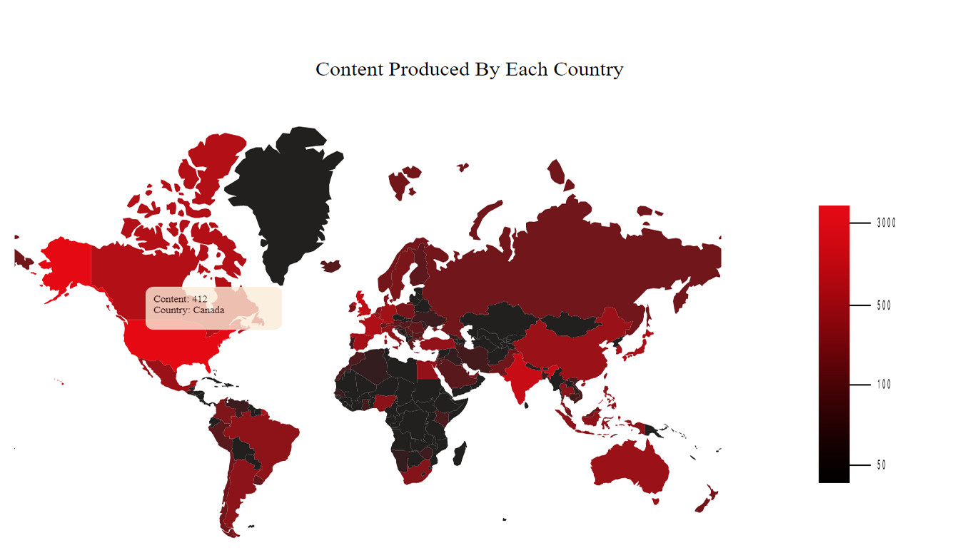
WHY – Geospatial visualization

Slide 7
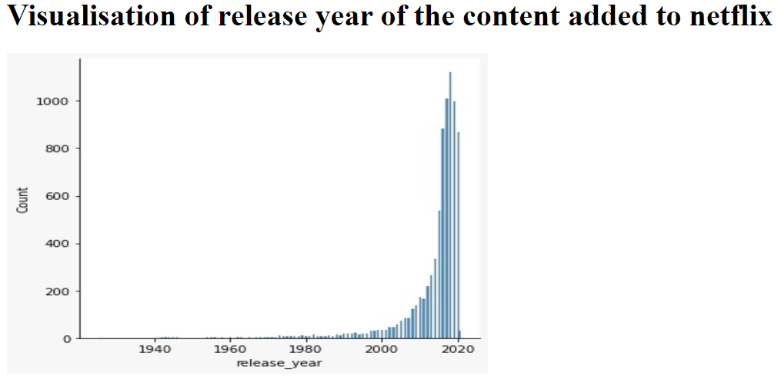
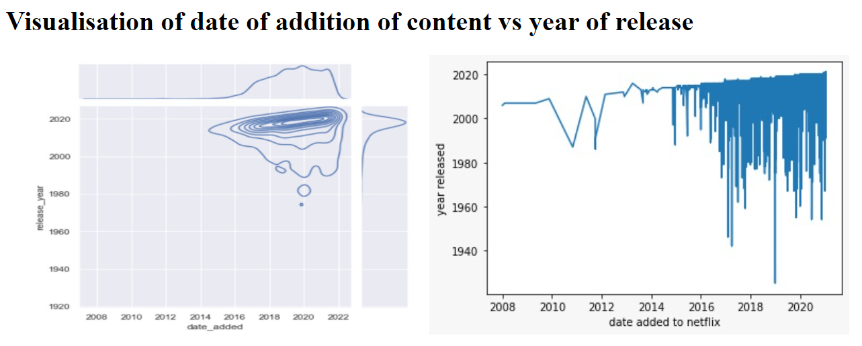
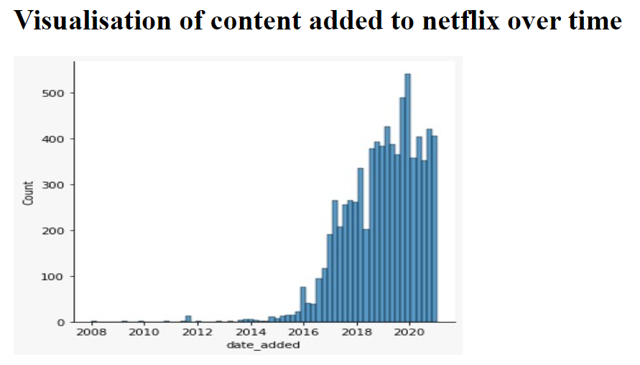
Why – time series analysis

Slide 8
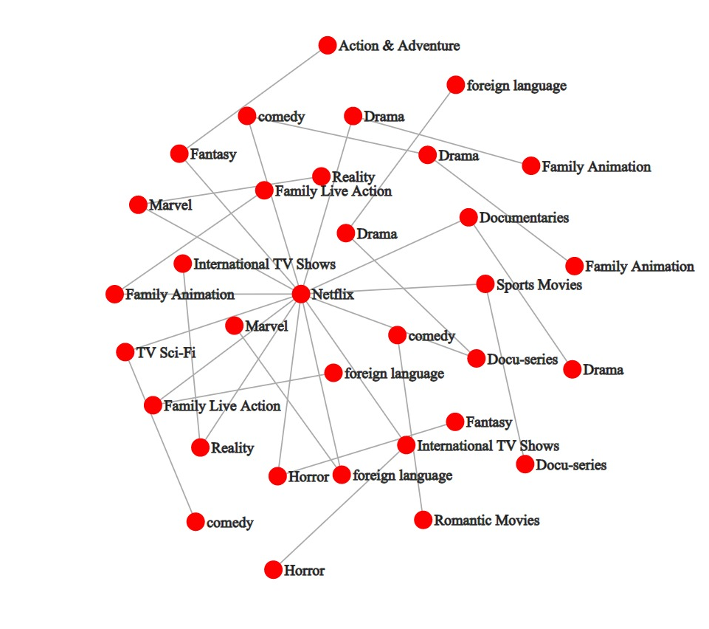

Why – force directed graph

Slide 9
HOW
Geospatial Visualization:-
By using D3 elements we were able to create a user interactive geospatial visualization, by which when we slide the cursor over various countries the amount of content of those countries on Netflix pops up.

Slide 10
HOW
TIME SERIES ANALYSIS:-
By using libraries of python like seaborn, matplotlib and plotly we were able to purify and sort the data accordingly, and then visualize it in a jupyter notebook to gain valuable insights.

Slide 11
HOW
FORCE DIRECTED GRAPH:-
How the visualisation works is The algorithm is based on a physical model. Nodes are represented as points in a plane that are electrically charged and apply repulsive forces against each other. Edges connect these points simulating a spring-force, attracting adjacent nodes..

Slide 12

Thank you

